Slide 1



Health tech
By team

Slide 2
What exactly is Health tech?
Healthcare technology ,commonly referred to as “health tech” refers to the use of technologies developed for the purposed of improving any or all aspects of healthcare system . It is the application of organized knowledge and skill in the form of devices ,medicines, procedures and systems developed to solve a health problem and improve quality of lives

Slide 3

Rise of mobile tech in health care over the years
Mobile computing carts in hospitals allow physicians to better engage patients under their care ,telemedicine means that the patient can access their care they need from wherever they are and wearable devices can be used to monitor at risk patients while minimizing cost through healthcare system.

Slide 4
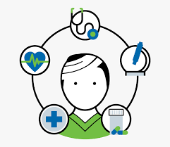
Patient centered care
Providing care that is respective of ,and responsive to individual patient preferences ,needs and values ,and ensuring that patient values guide all clinical decisions.
While the primary goal of any patient-centered care plan is to improve individual health outcomes, healthcare providers also stand to benefit through improved patient satisfaction scores, higher staff productivity and morale, reductions in the overall cost of care, and more. This makes patient- or family-centered care an approach worth exploring in almost any healthcare delivery setting.

Slide 5
How do we begin?
Creating the website
Links : Links with other websites are essential to allow patients to view similar information that may approach a problem from a different angle or in more detail and from a source that you would consider reliable.
Readability : This is the reading age to aim for in most patient information
Quality : Increasingly, patients obtain information from the Internet before the consultation and not all this material is of high quality
Advertisement :Patients need to know about your website.
Funding : When setting up a website you need to calculate the staffing and funding requirements

Slide 6
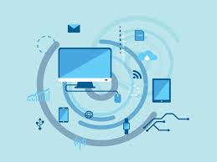
So what are the problems faced by the health tech ?
Enabling a patient centered information exchange system
Personal medical assistance

Slide 7

Requirements while enabling a patient centred information exchange system
Authorization
Confidentiality and Privacy of Patient Data
Data inconsistency
Timely access to the right record

Slide 8

Authorization
Identity and access management (IAM) systems reside at the center of cybersecurity strategies, providing the core identification, authentication and authorization services required to create secure technology environments
The signing of an authorization requires that providers retain a copy of each authorization and provides that an authorization may not permit the release of health record information relating to health care that is to be provided more than 90 days in the future. (Exceptions are made for disclosures to third-party payers, but they would be irrelevant for HDOs.)
Finally, a patient may revoke a disclosure authorization in writing at any time.

Slide 9

Privacy of Patient Data
In the context of health record information, confidentiality implies controlled access and protection against unauthorized access to, modification of, or destruction of health data.
We can manage this requirement by
Personnel control [eg: badges or other mechanisms to control entry or limit movement]
Management oversight [eg: periodic review of safeguards, unexpected inspections, policy guidance].

Slide 10

Data confidentiality and security
By using two-factor authentication to secure user accounts.
By encrypting personal medical data at two points in time: when the data is collected on the device and when it’s transferred to the server.
By incorporating a wipe feature to erase personal data from a device before the data can be stolen and misused.
By ensuring regular app testing and updates.
Lastly by offering automatic data restoration if a device is lost.

Slide 11
Timely access to the right record
Identifying the Critical Systems and Information
This asset list serves as an important tool to prioritize incident response efforts, strengthening protections around those systems and restoring them first in the event of a service disruption.
Updating Responses to Specific Threats
For example, ransomware attacks have increased dramatically over the past year. While we might treat this threat as similar to other malware threats from a prevention standpoint, ransomware raises new questions from an incident response perspective.
Lastly, by ensuring regular app testing and updates

Slide 12
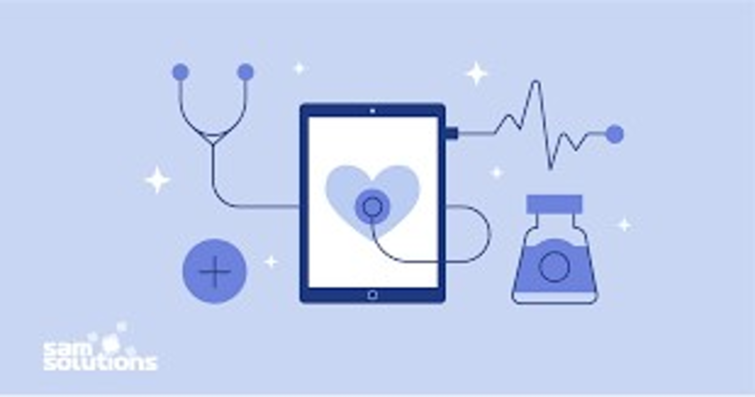
Personal medical assistance in Health tech
One way of providing personal medical assistance in health tech is via digital health care.
The broad scope of digital health includes categories such as mobile health (mHealth), health information technology (IT), wearable devices, telehealth and telemedicine, and personalized medicine.
From mobile medical apps and software that support the clinical decisions doctors make every day to artificial intelligence and machine learning, digital technology has been driving a revolution in health care. Digital health tools have the vast potential to improve our ability to accurately diagnose and treat disease and to enhance the delivery of health care for the individual.

Slide 13
Benefits of Digital Health Technologies
Digital tools are giving providers a more holistic view of patient health through access to data and giving patients more control over their health.
Reduce inefficiencies,
Improve access,
Reduce costs,
Increase quality, and
Make medicine more personalized for patients.

Slide 14
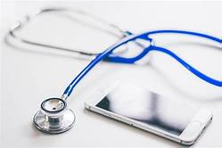
Lets consider Personal medical assistance through mobile health technology
Mobile health, abbreviated as mHealth is a collection of everything about public health, medicines, and patient care using mobile devices like tablets, laptops, cellphones, wireless infrastructure, and digital assistance
A signal processing algorithm looks for anomalies in an activity of vital organs that occur before serious, life or health threatening conditions like cardiac arrest, seizures, diabetic coma, etc. When an anomaly is detected, an alarm is triggered to warn the user and give him time to prevent or at least prepare for an upcoming attack.
The main application of mHealth is educating and creating awareness among the public.

Slide 15
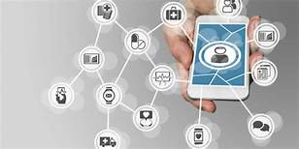
How does it work?
mHealth apps can include nutrition and fitness tracking apps, calorie counters, and other general wellness apps.
Identify a problem that needs to be solved : The key to successful mobile health application design lies in knowing how and why users will want to use the app
Know the target audience : providers need to know who will use this new app, and why
Combining text messages with links to secure websites, case managers can communicate:
Self-care
Testing and medication reminders
Questionnaires
Collection of participant data
Participant-specific health tips
Appointment reminders
Case manager and doctor notifications for certain triggers.

Slide 16


TEAM
TEAM MEMBERS:
KAVYASHREE S L (1KS19CS042)
MYTHREYI U (1KS19CS055)
NETHRA R (1KS19CS061)
NITHYA S N (1KS19CS063)
UNICORN
UNITY

